Slide 1


StoStock Market Trend Analyzer
2403A51071 P. RasagnaRanjani
2403A51072 K.Vishal Reddy
2403A51073 Byri Srikar

Slide 2



Objectives
To analyze stock price movements from CSV files
To detect overall market trend (Upward, Downward, Sideways)
To calculate slope using linear regression
To display highest, lowest, average stock prices
To visualize stock data using an interactive line chart
To show day-wise historical price changes

Slide 3

Stake holders
End Users / Investors – People who analyze stock trends
Developers / Student Team – Those who built and maintain the system
Faculty / Evaluators – Reviewing the project
Traders / Analysts – Can use the tool for quick stock overview
Organizations / Colleges – Supporting project development

Slide 4



Programming Languages, Tools and software
Languages Used:
Python
HTML
CSS
JavaScript
Tools Used:
Visual Studio Code
Browser (Chrome/Edge)
CSV Files for Input
Frameworks & Libraries:
Flask (Backend)
Chart.js (Graphs)

Slide 5
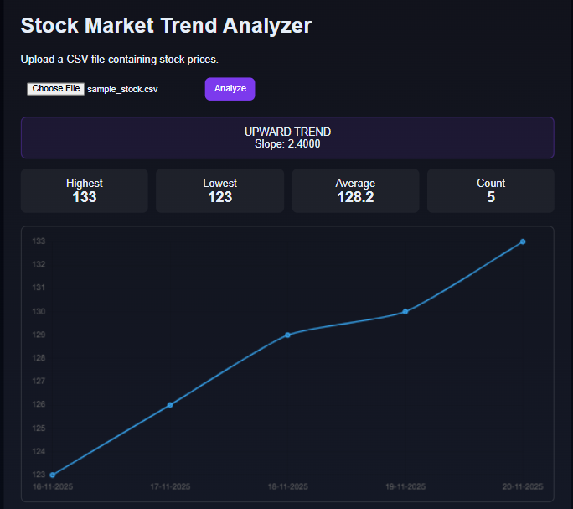
Front-End View of Application

Slide 6
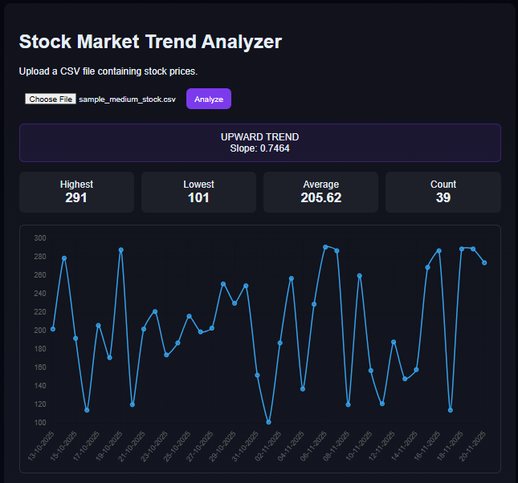

Slide 7
THANK
YOU.

